Slide 1
Attitude Representations
Quick & Dirty for use in software

Slide 2
Representing Attitude
There are several ways to represent the rotation between two reference frames
Direction Cosines
Euler Angles
Quaternions (aka Euler Parameters)
and more
They all have their strengths and weaknesses

Slide 3
Strengths and Weaknesses of Attitude Representations
Representation | Strengths | Weaknesses | Best Used For
Direction Cosines | Work well with vectors Easy to catenate rotations Moderately intuitive (dot products) No singularities | 9 params for 3 DOF | Transforming Vectors
Quaternions | Efficient (4 params for 3 DOF) No singularities | Not intuitive | Propagating Equations of Motion
Euler Angles | Intuitive 3 params for 3DOF | Singularities 12 Variants | Input, Output Gimballed Joints

Slide 4
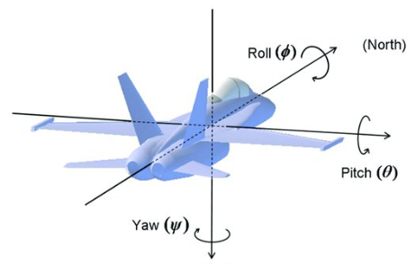
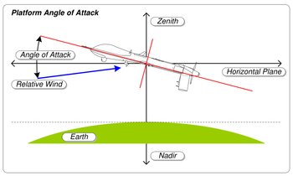
Euler Angles
Chronologically first in aerospace applications.
Generally works well for airplanes
Angles tend to be small deviations from the velocity frame
Good especially for small values
For small values, rotations approximately commute.
Satellite GNC used Euler angles for primary design into 1970’s.
Not great for satellites because satellites have arbitrarily large attitude deviations.
Control on euler angles highly non-linear
Euler angles and all three-parameter attitude descriptions have a singularity

Slide 5

Singularities
For high pitch, a small rotation
creates a large Yaw change

Slide 6
Non-commutative

Slide 7
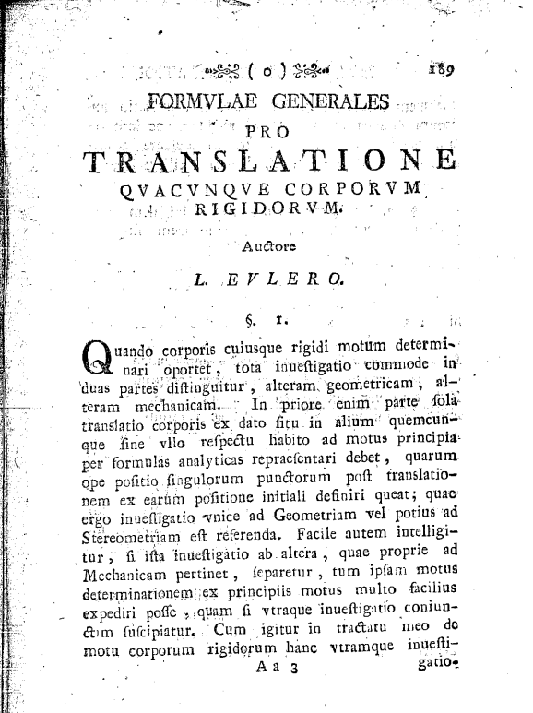
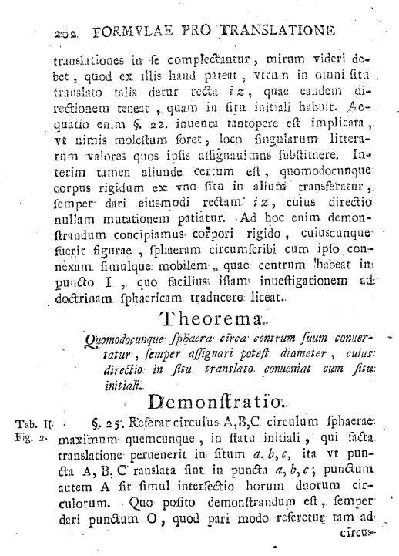
Euler’s Rotation Theorem (1776)

Slide 8
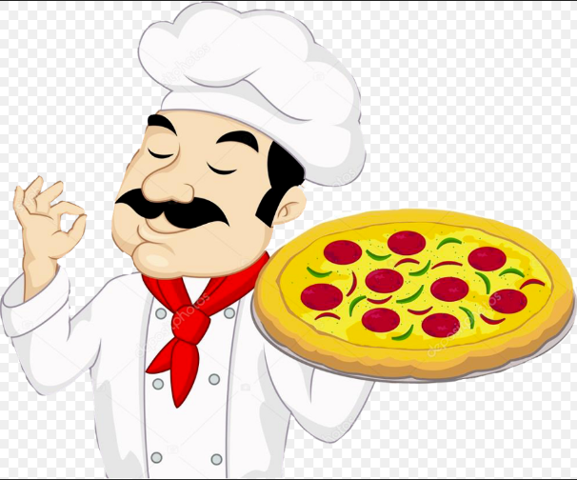

Euler’s Rotation Theorem
Theorema. Quomodocunque sphaera circa centrum suum conuertatur, semper assignari potest diameter, cuius directio in situ translato conueniat cum situ initiali.
n
θ

Slide 9
Euler’s Rotation Theorem
When a sphere is moved around its centre it is always possible to find a diameter whose direction in the displaced position is the same as in the initial position.

Slide 10
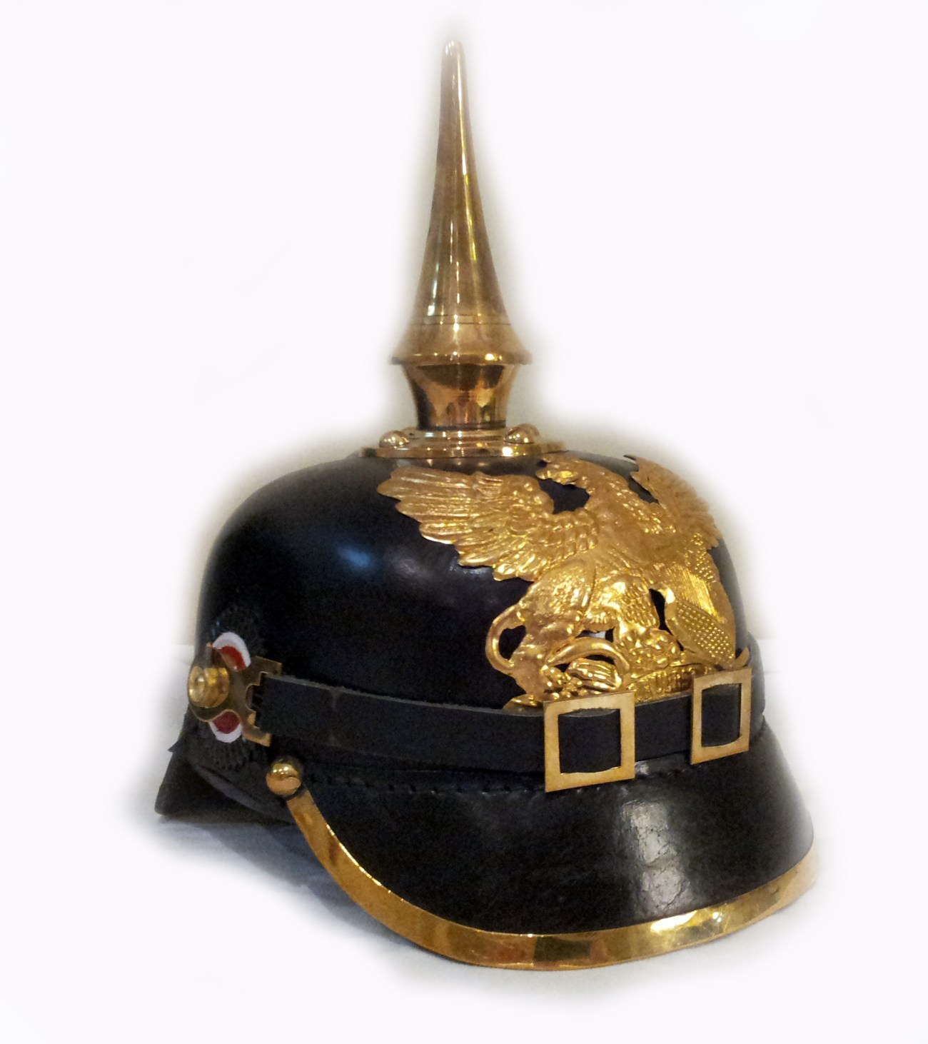
Euler Theorem in German
Egal wie sich die Kugel um ihren Mittelpunkt dreht, ihr kann immer ein Durchmesser zugeordnet werden, dessen Richtung in der Translationslage mit der Ausgangslage übereinstimmt.
Papillon
Farfalla
Butterfly
Fluture
Schmetterling

Slide 11
Direction Cosine Matrix (DCM)

Slide 12
Quaternions

Slide 13
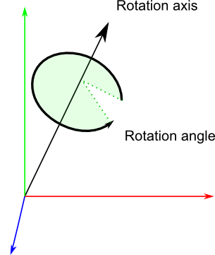
What a quaternion looks like

Slide 14
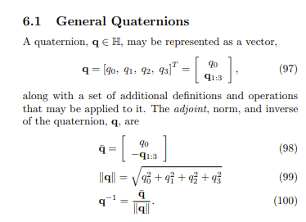
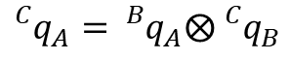
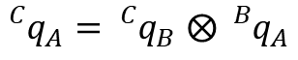
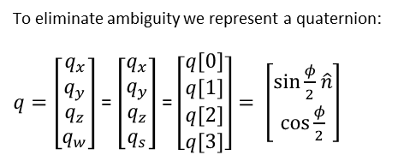
Quaternion Notation Issues
To eliminate ambiguity we represent a quaternion:
$q=\left[\begin{matrix}q_{x} \\ q_{y} \\ q_{z} \\ q_{w}\end{matrix}\right]$ = $\left[\begin{matrix}q_{x} \\ q_{y} \\ q_{z} \\ q_{s}\end{matrix}\right]$ = $\left[\begin{matrix}q[0] \\ q[1] \\ q[2] \\ q[3]\end{matrix}\right]= \left[\begin{matrix}\sin{\frac{φ}{2}\hat{n}} \\ \cos{\frac{φ}{2}}\end{matrix}\right]$
Scalar part
Scalar part
${}_{}^{C}{q_{A}=}{}_{}^{C}{q_{B}}$ $⨂$ ${}_{}^{B}{q_{A}}$
My notation (and JPL, 42’s) mimics DCM notation
$${}_{}^{C}{q_{A}=}{}_{}^{B}{q_{A}}⨂{}_{}^{C}{q_{B}}$$
Excerpt from https://www.astro.rug.nl/software/kapteyn-beta/_downloads/attitude.pdf
Hamiltonian Notation
Image Processing Might Used Conventions that differ from GNC!

Slide 15
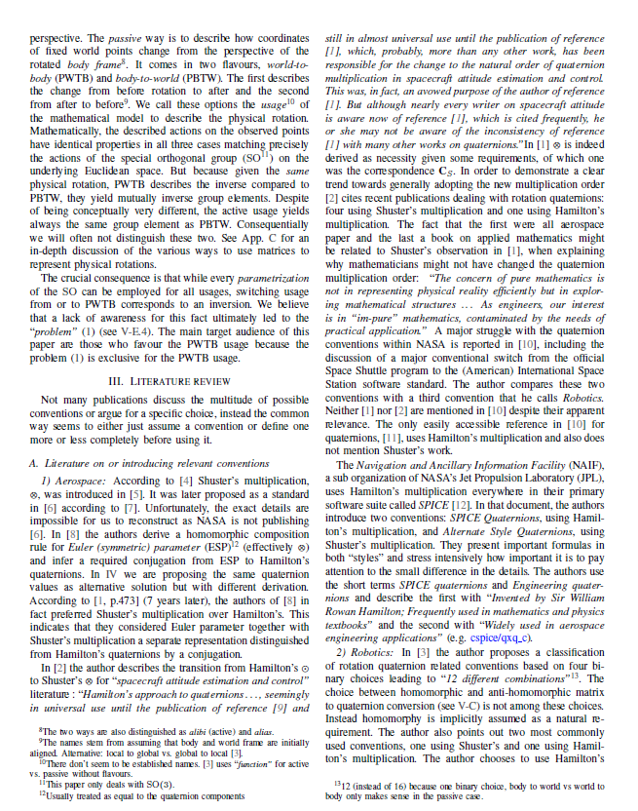
https://www.researchgate.net/publication/323426570_Why_and_How_to_Avoid_the_Flipped_Quaternion_Multiplication_-_Shorter_and_Less_Formal_Version

Slide 16
DCM’s & Quaternions

Slide 17
Matlab Interlude

Slide 18
Properties of Rotations

Slide 19
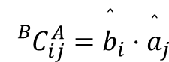
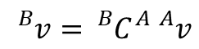
Notation for Quaternions, DCMs
The rotation from frame A to frame B may be described by the direction cosine matrix
Given the components of a vector in A, its components in B may be found by the multiplication
In C, we write the DCM as CBA to preserve order of superscripts, eg
Quaternions are another way to describe rotations. We use a parallel notation:
These and similar conventions promote concise, unambiguous code
$${}_{}^{B}{C_{ij}^{A}}={\overset{ˆ}{b}}_{i}⋅{\overset{ˆ}{a}}_{j}$$
$${}_{}^{B}v={}_{}^{B}{C_{}^{A}}{}_{}^{A}v$$
MxV(CBA,va,vb)
QxV(qba,va,vb)

Slide 20
References
http://www.opengl-tutorial.org/intermediate-tutorials/tutorial-17-quaternions/
https://en.wikipedia.org/wiki/Euler%27s_rotation_theorem
https://www.astro.rug.nl/software/kapteyn-beta/_downloads/attitude.pdf
https://fzheng.me/2017/11/12/quaternion_conventions_en/
http://www.iri.upc.edu/people/jsola/JoanSola/objectes/notes/kinematics.pdf
https://www.researchgate.net/publication/323426570_Why_and_How_to_Avoid_the_Flipped_Quaternion_Multiplication_-_Shorter_and_Less_Formal_Version

